Slide 1


Exam Planner – AI-Based Study Planning System
By Radhika Agarwal, CSE-AIML- D
Event : DeepMind GenAI Bootcamp

Slide 2

Problem Statement
  Students face difficulty in planning syllabus within limited exam time.
  Managing multiple subjects and deadlines manually is inefficient.
Static Timetables do not adapt to:-
  Exam Dates
  Study Hours
  Individual Needs
GOAL
To create a system that:
  Generates a personalized exam study plan.
  Breaks syllabus into day-wise tasks
  Helps students utilize limited time efficiently
  To provide a structured and easy-to-follow study schedule

Slide 3

AGENTIC AI
User
Agentic AI is an approach where the AI:
  Performs step-by-step reasoning
  Makes decisions during execution (When to think, when to act, when to use tools)
  Can use tools instead of only generating text
Streamlit UI
Unlike a traditional chatbot:
  It is not limited to a single prompt-response
  It can control the flow of actions
  The agent acts as a decision-making controller for the system
AI Agent (LangChain)
(Decision Making)
SYSTEM ARCHITECTURE
Tools & Logic Layer
(Day-wise distribution
Plan structuring
Logical separation of content)
The system is designed using a modular architecture.
Major components:
  User Interface (Streamlit): Collects user inputs
  AI Agent (LangChain): Interprets requirements and controls execution
  Tools & Logic Layer: Handles planning and structuring operations
  LLM: Generates structured study plans
  Output Layer: Displays results in calendar format
Data Flow:
User Input → Agent → Tools & LLM → Structured Output → UI
LLM
Output (Study Plan / Calendar View)

Slide 4







AGENT WORKFLOW
User Enter Details
The agent receives user inputs such as subjects, exam dates, and available study hours
KEY FEATURES
It analyzes constraints and planning requirements
  Personalized Study Plan Generation.📖
  Day-wise syllabus breakdown.
  Calendar-Style Visualization.📆
  Separate section of last-minute tips. 💡
  User-friendly interface.
The agent decides when to invoke tools for logical processing
It structures the syllabus into a day-wise study plan
Last-minute exam tips are generated separately
The final output is formatted and sent to the U

Slide 5
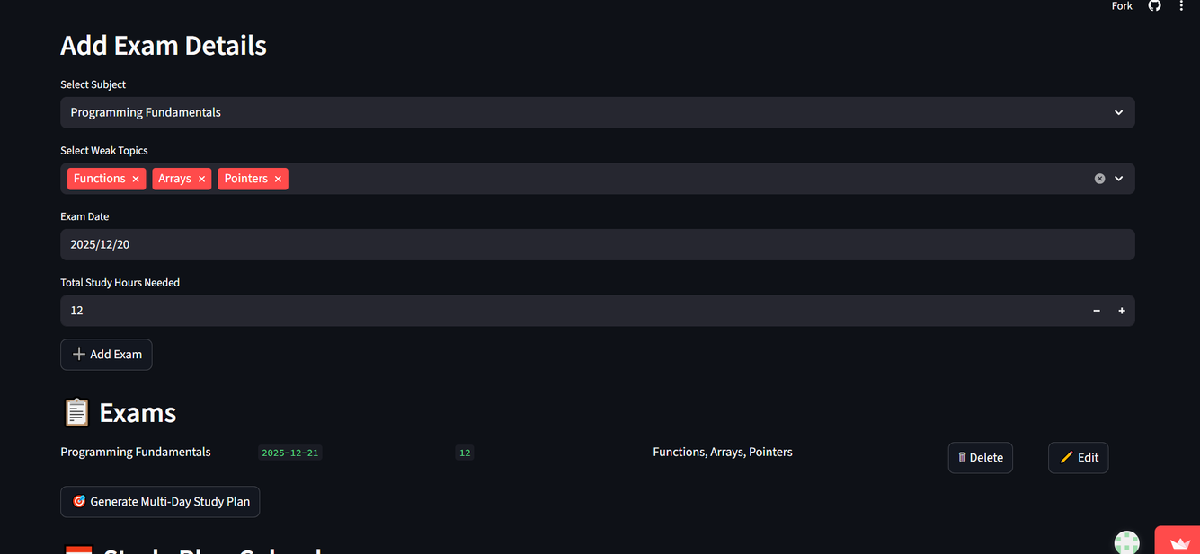
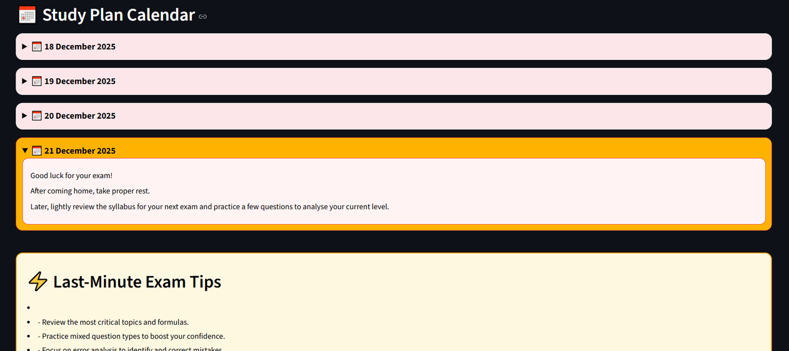
User Interface Screenshots
Project Link:-
https://exam-planner-w3gayxhcc5qo6dgmfhgvyu.streamlit.app

Slide 6


results & impacts
FUTURE SCOPE
  Reduced manual effort in exam planning
  Progress Tracking System & Adaptive Rescheduling
  Provides clear daily study direction
  Adaptive Rescheduling
  Helps students manage time more effectively
  Export Plan to PDF or Calendar
  Demonstrates practical use of Agentic AI
  User Login & Profile Management

Slide 7


